Slide 1
Annotated Photos of MODAC Kiln
On Google Drive
https://drive.google.com/drive/folders/1vT3xqBGDffVKJEHyx7Fh8LhRGOuSqF-o?usp=sharing

Slide 2
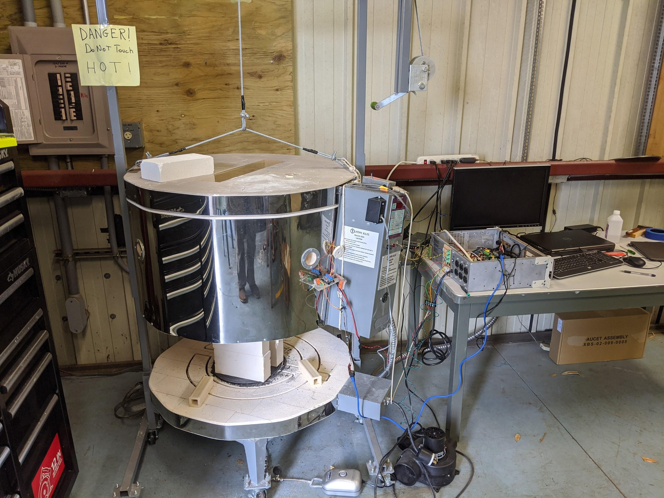
Kiln/MODAC Setup at IfA (june 2020)
Kiln Heater Switch
Main Power Strip (uncontrolled)
Main Power Breaker
Kiln Adjacent Sensors
MODAC Main Case

